Slide 1
Contact Tracing
Tracking potential COVID-19 contamination
Grupo 04
Matheus Franco 92523; Tiago Fournigault 92562; Guilherme Gaspar 102335

Slide 2
Introduction
The goal of this project is to identify potential contamination of COVID-19 based on user social interaction.
At the same time that it is affected by the person’s whereabouts and daily routines, the application must maintain the privacy of each user.
The app should:
inform others that the user is infected (using a code given by a health authority) and
Inform the user if he was in contact with someone infected, alongside with an description of where the contact occurred and its time.

Slide 3
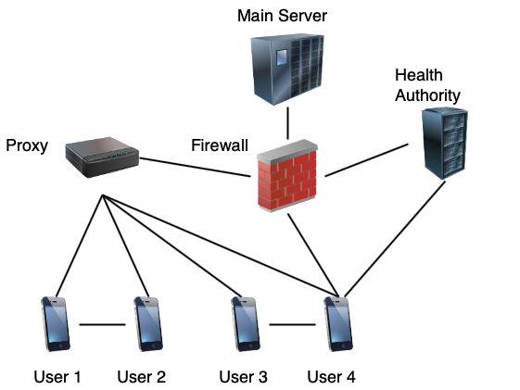
General Architecture
Main server (+ firewall)
Proxy
Health Authority
Users

Slide 4
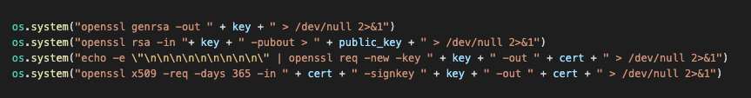
Key Distribution and Management
Each entity has its own public and private key alongside with a certificate, which
is assumed to be signed by a Certificate Authority.
The public keys of the main server, the proxy and the sns (Health Authority) are
previously known. For each user, on the other hand, it’s generated
in the beginning of the execution by the app.
Generation of keys and certificate

Slide 5
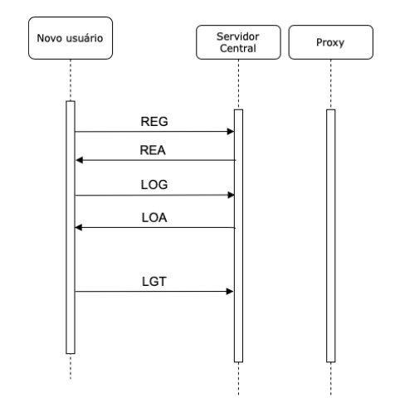
Developed Protocol
User Registration and log in:
REG:<name>:<password>:\n
REA:\n
LOG:<password>:\n
LOA:(<logged_ip>:)*\n
LGT:\n

Slide 6
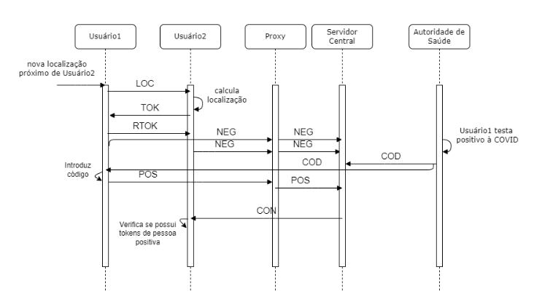
Developed Protocol
Social interaction:
LOC:<latitude>:<longitude>:\n
TOK:<mytoken>:\n
RTOK:<mytoken>:\n

Slide 7
Developed Protocol
Positive test:
COD:<sns_code>:\n
POS:<sns_code>:(<token>:)*\n
CON:(<token>:)*\n
NEG:\n

Slide 8
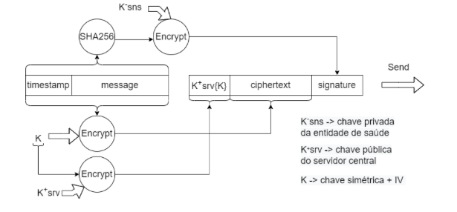
Developed Protocol
Positive test (sns to server message)

Slide 9
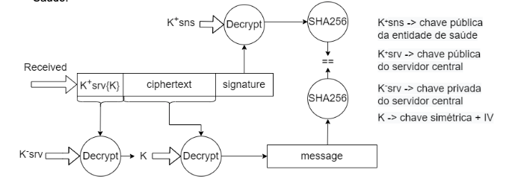
Developed Protocol
Positive test (sns to server message)

Slide 10
References:
D3PT - Decentralized Privacy-Preserving Proximity Tracing
(https://github.com/DP-3T/documents)
Apple and Google Privacy-Preserving Contact Tracing - joint documentation from the two
leading smartphone OS providers.
(https://covid19.apple.com/contacttracing)
Project Description (https://github.com/tecnico-sec/Project-Topics-2022_1)
Slides from theoretical classes
(https://fenix.tecnico.ulisboa.pt/disciplinas/SIRS/2021-2022/1-semestre/teoricas)

